Slide 1
PMCG-316:
Intro to Web Development
Karl Hohn, Instructor

Slide 2
Goals
By the end of this course you should:
Have a solid grasp on the basics of HTML, CSS, and JavaScript
Understand the tools and resources available to you as a web developer
Know how to use Git and GitHub
Publish a personal portfolio site on GitHub Pages

Slide 3
About Me
BA: Music Synthesis, Berklee College of Music, 2009
MS: Integrated Digital Media, NYU Polytechnic School of Engineering, 2014
Have worked for ecommerce companies, media startups, & creative agencies and worked on sites for clients like Samsung, Condé Nast, and ProPublica
Babycastles, 2016-present: video games, art installations, & events

Slide 4



How do websites work?*
DNS Lookup
Client (you)
Server
*(a simplified explanation)
https://medium.com/@maneesha.wijesinghe1/what-happens-when-you-type-an-url-in-the-browser-and-press-enter-bb0aa2449c1a

Slide 5
“Front End” vs. “Back End” development
Front end /
Client-side
Back end /
Server-side
Code runs in the browser (on your computer)
Displays data & media to the user
Handles user input and interaction
Sends requests to the server
Code runs on the server (another computer)
Handles requests from the client
Stores & recalls data from databases
Processes data

Slide 6
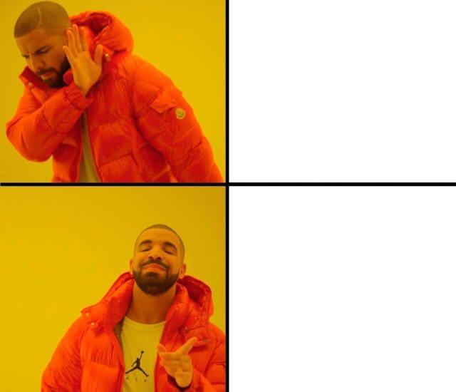

Slide 7
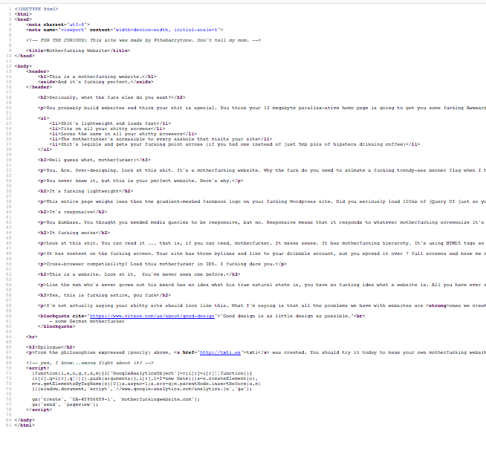



Anatomy of a Web Page
{
}
Head
<meta>
}
Document
Body
}

Slide 8
What tools do I need to build web pages?
Browser
Code Editor
Sublime Text https://www.sublimetext.com/3
Atom https://atom.io/
Brackets http://brackets.io/
Version Control
Git https://git-scm.com/
GitHub https://github.com/
Command Line
https://help.github.com/articles/generating-a-new-ssh-key-and-adding-it-to-the-ssh-agent/
https://help.github.com/articles/adding-a-new-ssh-key-to-your-github-account/

Slide 9





Which browser?

Slide 10
Developer Tools
View -> Developer -> Developer Tools
Command+Option+I (Mac)
F12 or Control+Shift+I (Windows)
https://developers.google.com/web/tools/chrome-devtools/shortcuts

Slide 11
Git and GitHub
What is Git?
Git is a branching version control system for tracking changes to code bases
Code goes in a repository and changes are tracked by commit history
What is GitHub?
GitHub is a website for hosting Git repositories
It facilitates collaborative software development by allowing developers to easily share code, track changes, and create wiki’s for projects

Slide 12
Resources
Good sites to go to for reference:
Mozilla Developer Network https://developer.mozilla.org/en-US/
W3schools https://www.w3schools.com/
CSS Tricks https://css-tricks.com/
CodePen https://codepen.io/
StackOverflow https://stackoverflow.com/

Slide 13
Resources
Places to go for inspiration:
Awwwards https://www.awwwards.com/
NewHive http://newhive.com/
Glitch https://glitch.com/

